Slide 1

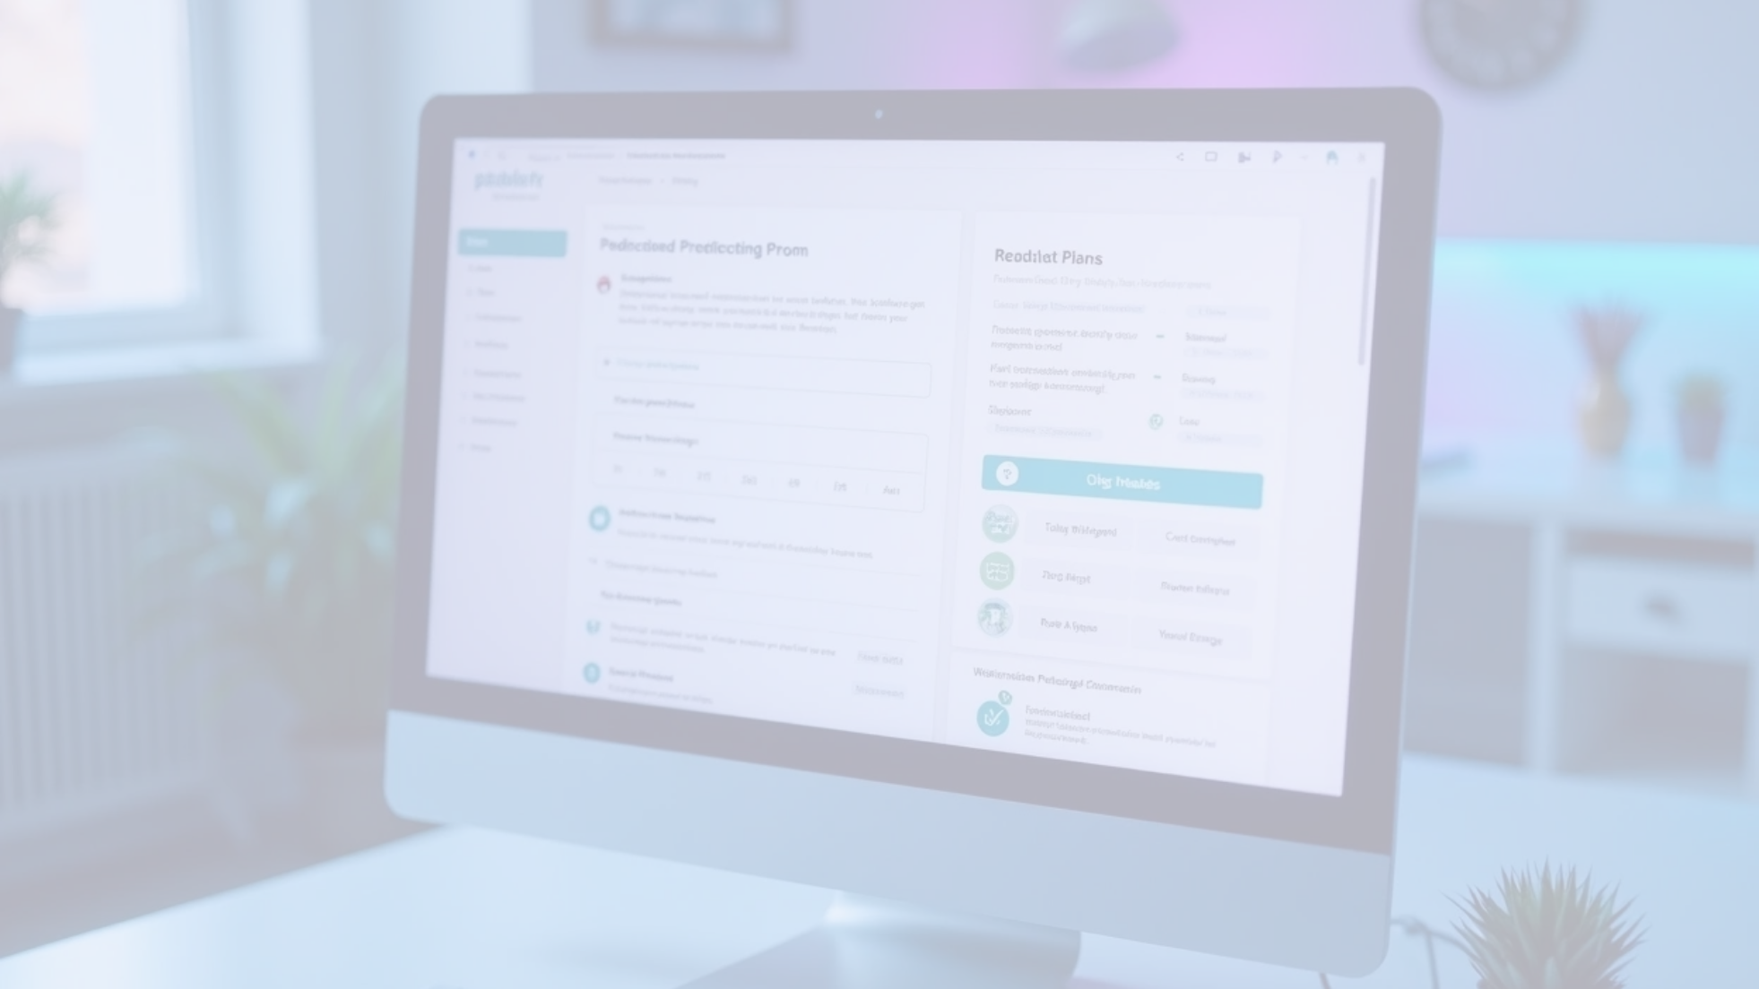
Medicine Recommendation System
A Medicine Recommendation System designed to predict potential diseases based on symptoms entered by users. It offers comprehensive disease descriptions, necessary precautions, recommended medications, tailored workout plans, and dietary suggestions aimed at facilitating user recovery. This innovative solution enhances user engagement and promotes better health management.

Slide 2



System Overview
Purpose of the System
User Interaction
Comprehensive Guidance
Assist users in identifying potential diseases based on symptoms.
Users input symptoms for the system to analyze and predict diseases.
Recommend medications, workouts, and diet plans for holistic health management.

Slide 3



Disease Prediction Mechanism
Machine Learning Models
2
Advanced machine learning models will be employed to continuously improve the prediction accuracy based on user data and feedback.
Symptom Analysis
The system utilizes algorithms to evaluate symptoms entered by users, enhancing accuracy in disease prediction.
1
Database of Diseases
A comprehensive database of diseases and their symptoms will be maintained to ensure up-to-date and reliable information for users.
3

Slide 4

Disease Description and Precautions
Detailed Disease Info
Comprehensive overview including causes and symptoms.
Precautionary Measures
Personalized tips to avoid worsening conditions.
Emergency Guidance
Advice to seek immediate medical attention for severe symptoms.

Slide 5

Medication Recommendations
Personalized Medication List
The system generates a recommended medications list.
Drug Interactions
Checking for potential drug interactions to ensure safety.
Pharmacy Locator
Feature to find nearby pharmacies for medication retrieval.

Slide 6



Personalized Workout Plans
Activity Tracking
Users can log their workouts, and the system will adjust plans according to their progress and feedback.
Tailored Exercise Regimens
Expert Recommendations
The system will create personalized workout plans based on the user’s health condition to promote recovery and physical fitness.
The program will include advice from fitness experts on safe exercises suitable for specific health issues.
2
1
3

Slide 7


Dietary Suggestions
Nutrition-Based Recommendations
Meal Plans
Food Allergies and Preferences
Customized meal plans for balanced nutrition.
Consideration of allergies and preferences.
Alleviating symptoms and promoting healing.

Slide 8


User Interface Design
The design of the user interface focuses on usability, visual representation of data, and accessibility across devices. It aims to empower users by making information easily understandable and accessible at all times.
User-Friendly Interface
Visual Data Representation
Mobile Accessibility
The system will feature an intuitive interface, making it easy for users to input symptoms and navigate recommendations.
Graphs and charts will be used to present health data, progress, and recommendations in a clear and engaging manner.
The system will be accessible on various devices, including smartphones and tablets, ensuring users can receive guidance anytime.

Slide 9




Future Enhancements
2
Community Support Features
A forum or community feature will enable users to connect, share experiences, and support each other in their health journeys.
Integration with Wearable Devices
Future versions of the system may integrate with wearable health devices to provide real-time health monitoring and personalized recommendations.
1
Continuous Learning
The system will be designed to learn from user interactions, improving its recommendations and predictions over time.
3

Slide 10



Conclusion of the Medicine Recommendation System
Holistic Health Approach
Empowering Users
Future Potential
This medicine recommendation system aims to improve user health by providing comprehensive, personalized care based on symptoms and lifestyle.
By educating users about their health conditions and offering actionable recommendations, the system empowers individuals to take charge of their health.
With ongoing improvements and expansions, this system has the potential to become an essential tool in preventive healthcare and wellness management.

